Slide 1

Airbnb
Rohan Argalmani
Internship ID: CRIN2301847

Slide 2
Objective:
Objectives: Research Questions:
Regarding the Host
● Who is the top earners.
● Is there any relationship between monthly earnings and prices
Regarding the Neighbourhood
● Is Any particular location getting a maximum number of bookings
● Price relation with respect to location
Regarding the reviews
● Relationship between Quality and Price
Regarding Price
● Price vs amenities
● Price vs location

Slide 3
APPROACH FOR DATA ANALYSIS :
Using Various Charts and visualization to make things look easy and simple to understand.
01
Bar-Chart
02
Line
used to represent categorical values.
Used to representation of assest historical price action in series of values.
Geographic
03
04
Heatmap
It is used to show details according to location provided..
Graph that represents of data where values are depicted by colour..

Slide 4
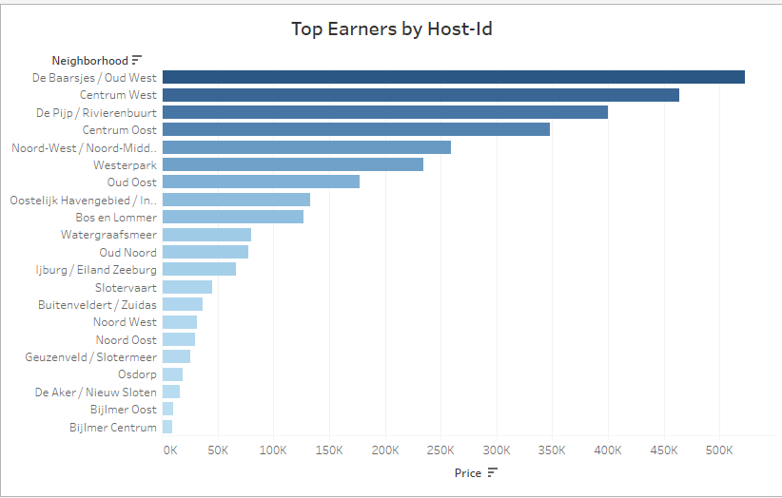

Top Earners By Host
Here we can that Oud west / De Baarsjes and centrum west are the two location where when host own hotels to reside and earn maximum porfit as compared to other location or city.

Slide 5
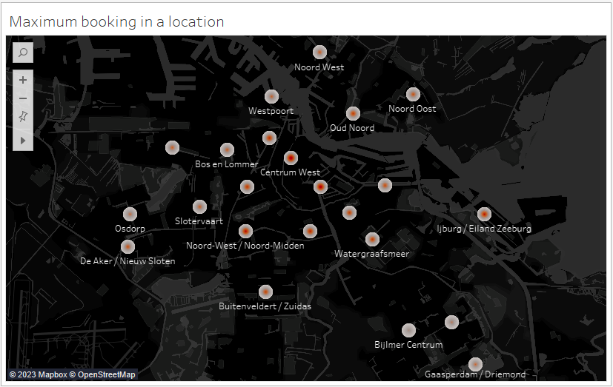
Maximum bookings:
The top three Maximum Booking are at the location of “Centrum west ,Oud west / De Baarsjes, Eiland Zeeburg according to the density of population.

Slide 6
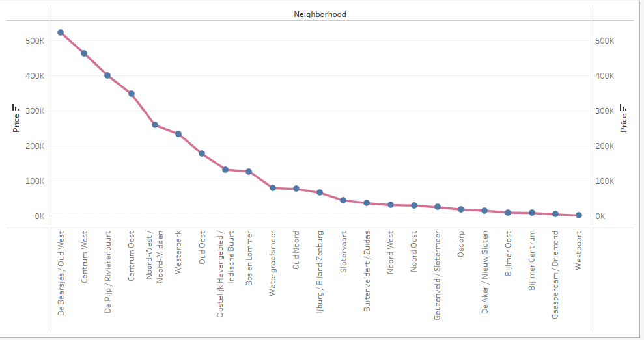
Price and Location:
Here we can see that the price of Hotels/Appartment// home-stay incresing becaues of demand and service provided.

Slide 7
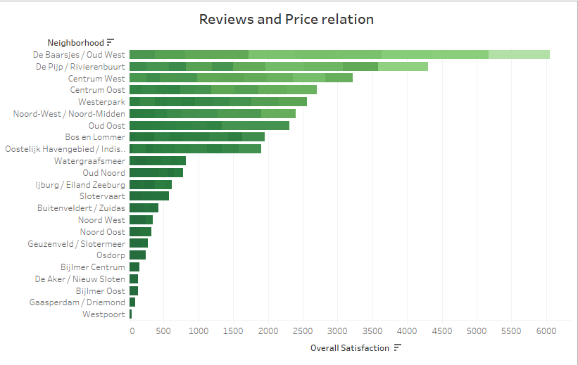
Reviews and Price Relation:
In this graph we see that hotel are assigned according to the Customer service review and Affordble-Prices.

Slide 8
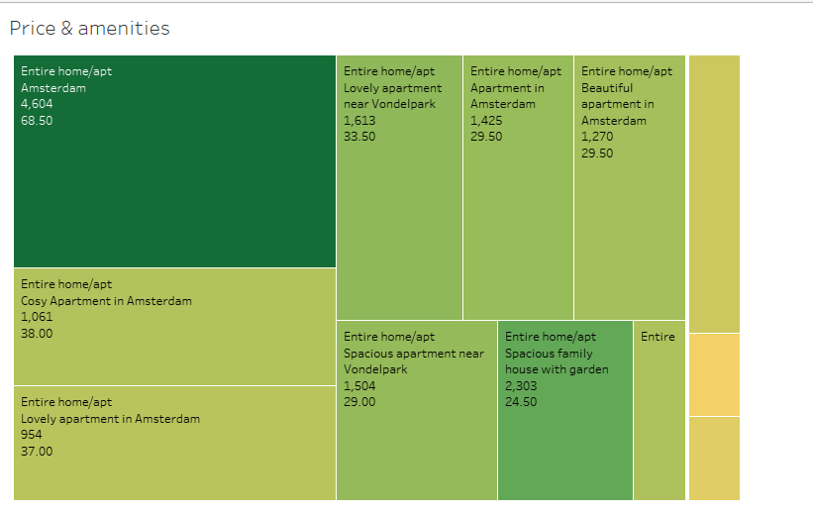
Price & Amenities:
Here the graph is reppresented according to most overall Satisfaction and Most recomended hotel by Price and Customer Satisfaction.

Slide 9
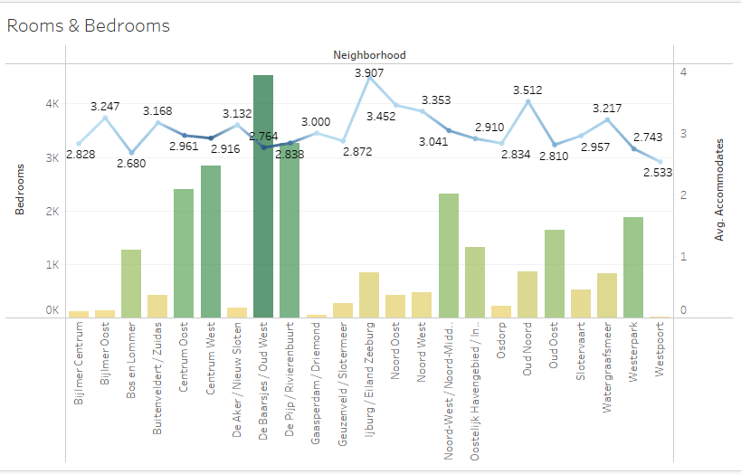
Hotels-stay & Room type :
Reviews from the past graphs and represnted the price validatioin for hotel accomodation and here we see the number days accomodated depending on price and overall Satisfaction, In which “Oud-west, Reviernbuurt are the likely hotels or appartment to stay.

Slide 10
Location
Price.
CONCLUSION
Reviews.
Overall Satisfaction
From the above Points we conclude that Hotel at centre of city-location with Good service and neighbourhood, Improves the Attraction of people , increases the Profitability in that location.

Slide 11
THANKS
Tableau LINK : https://public.tableau.com/views/Airbnb_16880344835040/Dashboard1?:language=en-US&publish=yes&:display_count=n&:origin=viz_share_link
Python Notebook: http://localhost:8889/notebooks/Downloads/Airbnb%20EDA.ipynb

